Slide 1
CS 521
Technological Foundations of Blockchain and Cryptocurrency
Grigore Rosu
Topic 2 – Basic Crypto Primitives

Slide 2
Thanks!
To Professors
David Tse (Stanford)
Sriram Viswanath (UT Austin)
Sreeram Kannan (UW – now at EigenLayer)

Slide 3
Some crypto primitives
Encryption and Signatures
Cryptographic Hash Functions
Hash Accumulators
Blockchain
Merkle trees

Slide 4
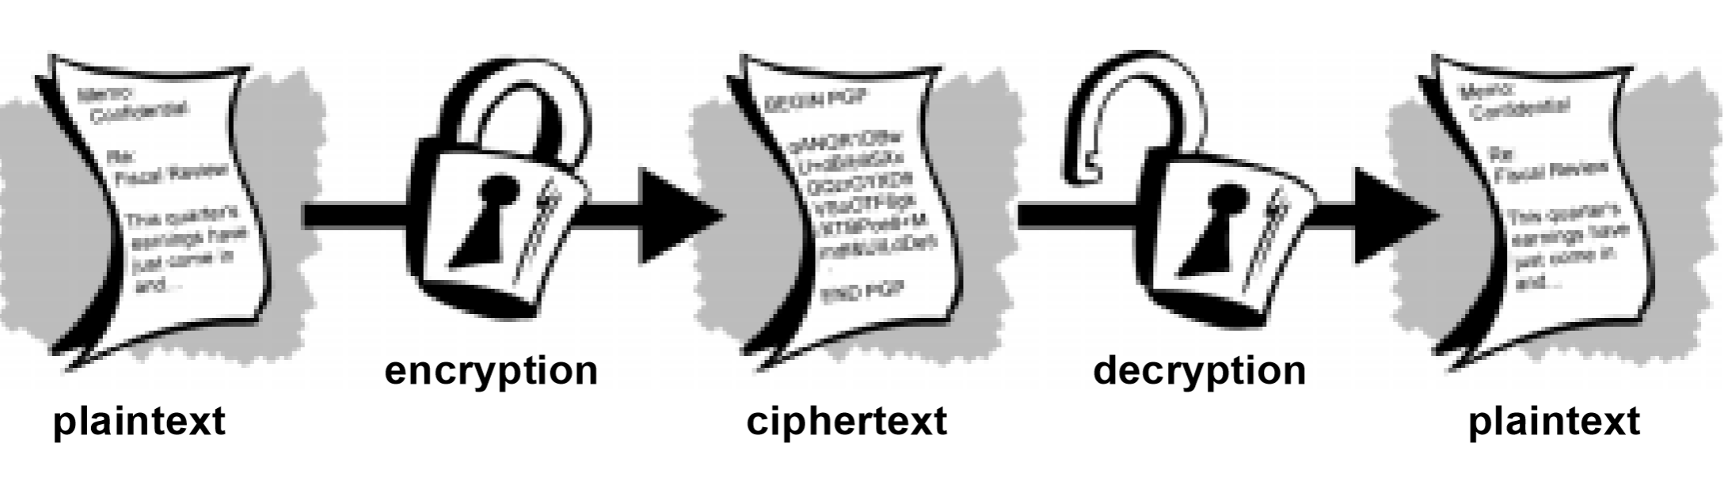
Basic Encryption

Slide 5
Encryption
Decryption
hello
lipps
hello
plaintext
ciphertext
plaintext
Cypher: Offset the Alphabet
Key: 4

Slide 6
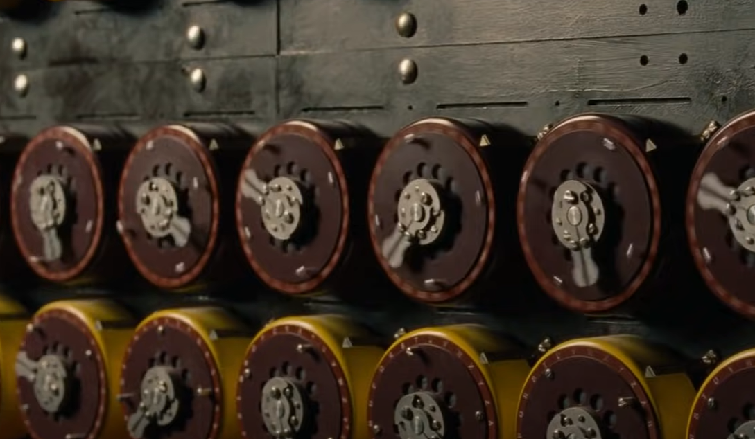
Scene from “Breaking the Enigma Code”
https://youtu.be/zZuqLLdx2YQ

Slide 7
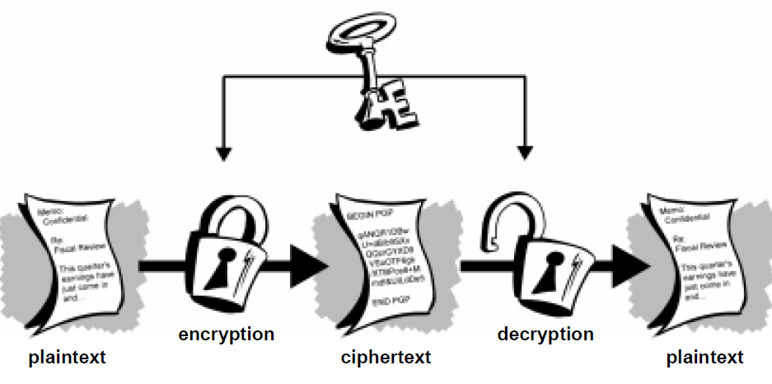
Symmetric Key Cryptography

Slide 8
Pros and Cons
High performing – fast, especially if the data is not going to be transmitted
Can be implemented in hardware and software
Secure key distribution is difficult, requires trust and secrecy between the parties as well as trust for the “distribution mechanism” if the parties are not in the same location

Slide 9

Public-Private (aka Public-Key) Cryptography

Slide 10
Pros and Cons
People can exchange messages securely without a security arrangement
Makes secure message exchange available to a wider group of people
Does not ensure foolproof identity of the sender

Slide 11

Digital Signatures

Slide 12
Digital Signatures
Key generation
(secretkey,publickey) =
Generatekeys(keysize)
Randomized function
Signature
Sig =
sign(secretkey, message)
Verification
verify(publickey,Sig,message)

Slide 13
Unforgeable Signatures
Unforgeable
Computationally hard to generate a verifiable signature without knowing the secret key
ECDSA
Elliptic Curve Digital Signature Algorithms
Cryptographically secure against an adaptive adversary

Slide 14
Decentralized Identity Management
Public keys are your identity
address in Bitcoin/blockchain terminology
Can create multiple identities
(publickey, secretkey) pairs
Publish publickey
Sign using secretkey
Can create oneself
Verifiable by others

Slide 15
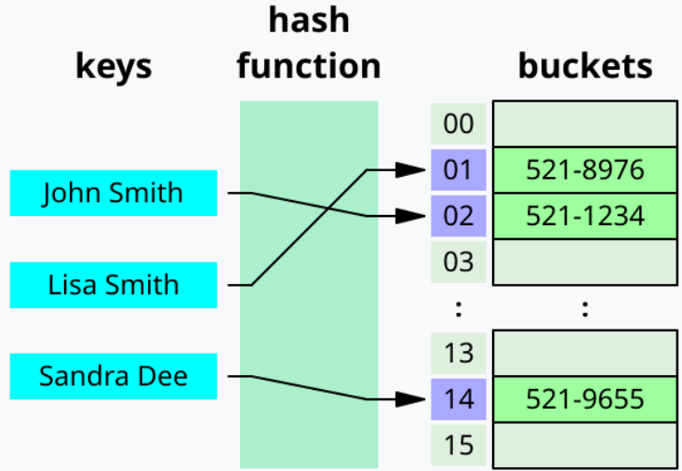
Hash Functions
Defining Properties:
Arbitrary sized inputs
Fixed size deterministic output
Efficiently computable
Minimize collisions
Canonical application:
Hash Tables
Store and retrieve data records

Slide 16
Example: Hash Functions
Division hashing
Uniform output
Simple deterministic function
Collision resistant

Slide 17
Cryptographic Hash Functions
Extra Properties:
Adversarial collision resistance
Birthday paradox
One way function
Specialized one way function
Canonical applications:
Message digest
Commitments
Puzzle generation
Mining process

Slide 18
Hashing Algorithms
NSA 2001
No Collisions (yet)
Collisions found!

Slide 19
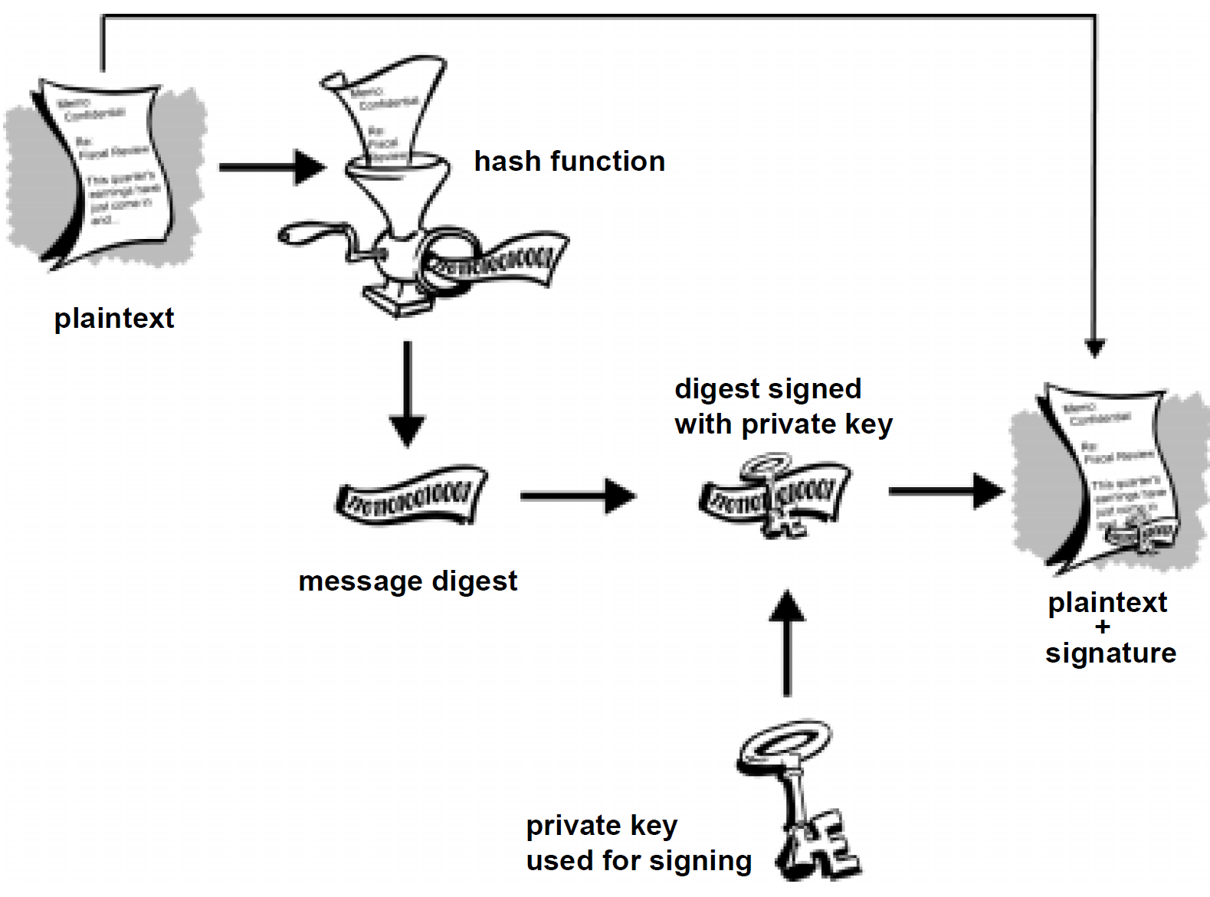
Basic building blocks together

Slide 20
Hash Pointer
Pointer to:
location of information
+ hash of the information
Regular pointer
retrieve information
Hash pointer
retrieve information and verify the information has not changed
Regular pointers
Used to build data structures
linked lists, binary trees, etc
Hash pointers
Can also be used to build data structures
Crucially useful for blockchains!
Blockchain = hash pointer based data structure

Slide 21
Blockchain: a linked list via hash pointers
Block: Header + Data
Header: hash pointer to
location of previous block
+ hash of the previous block
Data: information specific to the block (e.g., transactions)
Application: tamper evident information log
Head of the chain being known is enough to find tamper evidence in any internal block
Hence the phrase: block chain
blockchain

Slide 22
Merkle Tree
Binary tree of hash pointers
Retain only the tree root
Tamper of any data in the bottom of the tree is evident
Proof of Membership
Proof of Non-membership

Slide 23
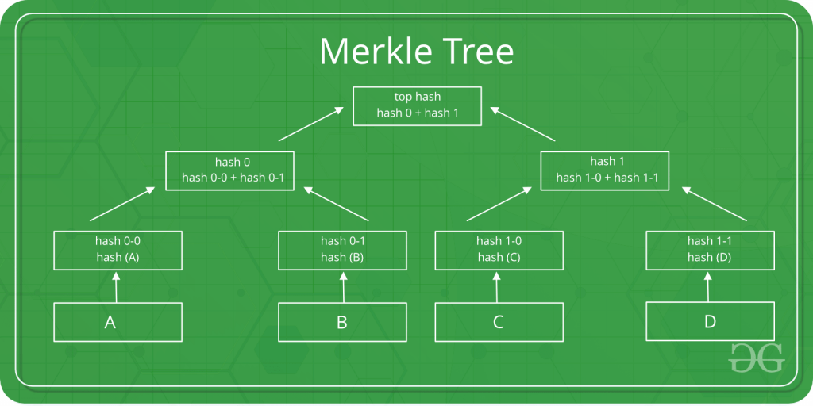
Merkle Trees
Block: Header + Data
Header: Pointer to
location of previous block
+ hash of the previous block
Data
block specific information

